Slide 1
UNCLASSIFIED
National Industrial Security Program (NISP) – Protection and Defense of Information Systems in the Defense Industrial Base
Presented by:
Alexander Hubert, CISSP, Eastern Region Authorizing Official (AO)

Slide 2
Agenda
UNCLASSIFIED
Abstract
Meet Us!
  DCSA NAO Office
  DCSA RAO and Staff
Cybersecurity Tool Set
NISP RMF Implementation
Regional RMF Workload
Cyber Risk
Cyber Compliance
Contrast Cyber Risk and Cyber Compliance
Conclusion
References
Questions and Discussion

Slide 3
Abstract
UNCLASSIFIED
Risk Management Framework (RMF) is a risk-based approach to cybersecurity. Authorization to Operate decisions are based on residual risk and Authorizing Official (AO) risk appetite. Operational need is considered with push note from Government Contracting Agent (GCA).
32 CFR Part 117 is law; compliance is mandatory. Part 117.18 directs compliance with Information System Security.
DoDM 5220.32 Volume 1 is informational to industry and “implements policy, assigns responsibilities, establishes requirements, and provides procedures, consistent with Executive Order (E.O.) 12829, (Manual 5220.32 Volume 1), and E.O. 10865, for the protection of classified information that is disclosed to, or developed by contractors, licensees, and grantees (referred to in this manual as contractors) of the U.S. Government (USG).”
  RMF security controls are implemented in accordance with RMF implementation guidance as outlined in NIST SP 800-53r4
  Non-compliance with an RMF security control will drive a Plans of Action and Milestone (POAM) document and determination of residual risk
  If the non-compliant control references a compliance item in 32 CFR Part 117, then that finding becomes an administrative finding or vulnerability
  Team work makes the dream work! DCSA ISSPs work together with Contractor ISSMs to ensure a
  complete and accurate site picture and enable a risk-based Authorization to Operate decision. Also
  responsible for security oversight during security reviews and onsite assessments

Slide 4
The DCSA Cybersecurity Team – NAO Office
UNCLASSIFIED
National Industrial Security Program (NISP) Authorization Office (NAO)
  Responsible for execution of NISP Risk Management Framework (RMF)
    DCSA Assessment & Authorization Process Manual (DAAPM)
    NISP Connection Process Guide (in draft)
    Internal Security Operating Manuals – Internal Instruction
    Quality Assurance & Consistency
    Field support, policy interpretation and guidance
    Interconnection Agreements, Memorandum of Understanding (MOU/MOA)
    Army SAP oversight
  NISP Enterprise Mission Assurance Support Service (eMASS)
  NISP Assessment & Authorization Metrics
  DCSA Command Cyber Readiness Program (CCRI)
  Government & Industry stakeholder engagements

Slide 5
The DCSA Cybersecurity Team – RAO & Staff
UNCLASSIFIED
Regional Authorizing Officials (AO) - direct report to Regional Directors; appointed officials responsible for authorization of NISP classified systems
Supervisory Team Leads (TL) direct report to Regional AO; manage respective ISSP workload; Quality Assurance on ATO packages
Cyber Team Leads (5)
  Lead Command Cyber Readiness Inspections (CCRIs)
  Cybersecurity SME
Information System Security Professionals (ISSP)
  RMF Security Control Assessors (SCAs)
  Security Reviews
  Onsite Assessments
  Administrative Inquiries (AI) – i.e. classified data spills
  Command Cyber Readiness Inspection (CCRI) Certified Technical Reviewers (Network, Operating System, End Point Security, Insider Threat, Vulnerability Scanning)
  Electronic Communication Plan (ECP); FOCI Mitigation
  Stakeholder Engagement (local working groups, training, guidance)

Slide 6
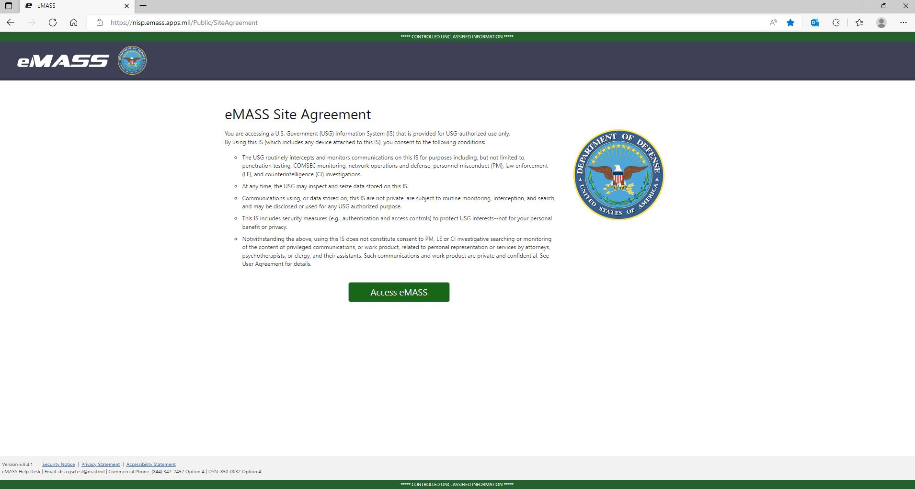
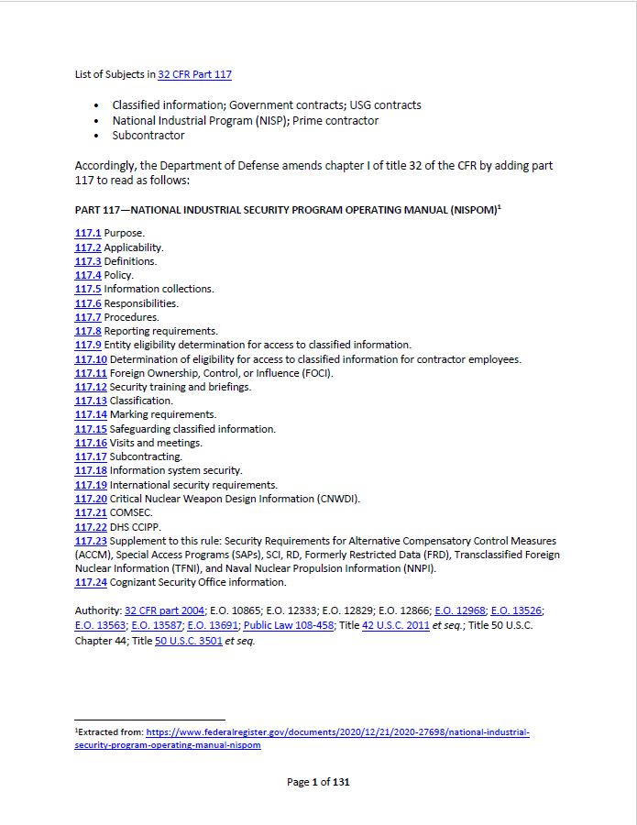
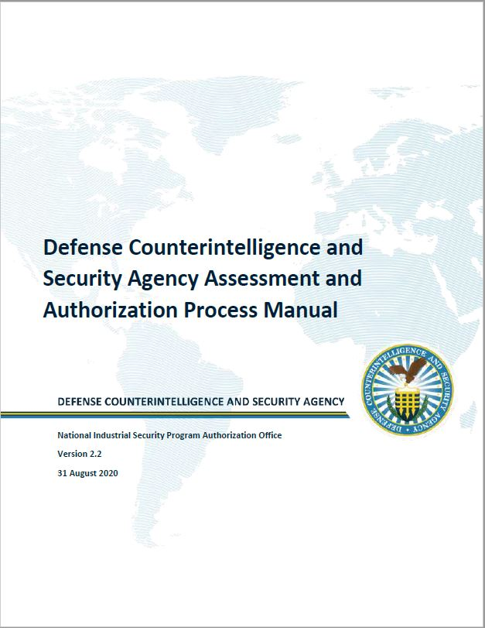
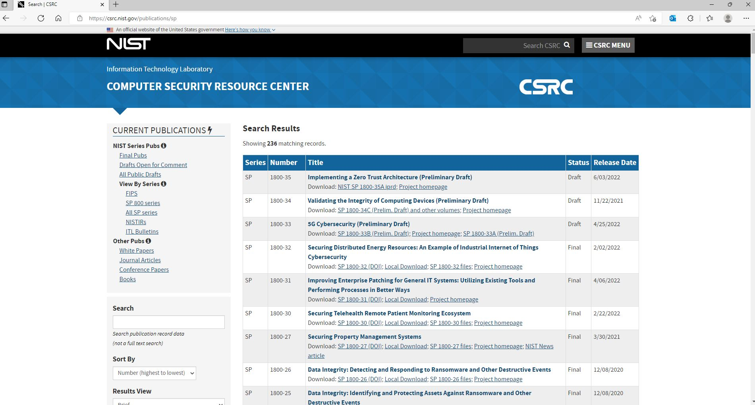
Cybersecurity Tool Set
UNCLASSIFIED

Slide 7
UNCLASSIFIED
NISP RMF Implementation
Change
Change
Analysis
Continuous Monitoring
Prepare
Authorize
System
Decision
Categorize
Assess
Select
Implement
GCA (i.e. dd254)
Industry Action
DCSA Action
7

Slide 8
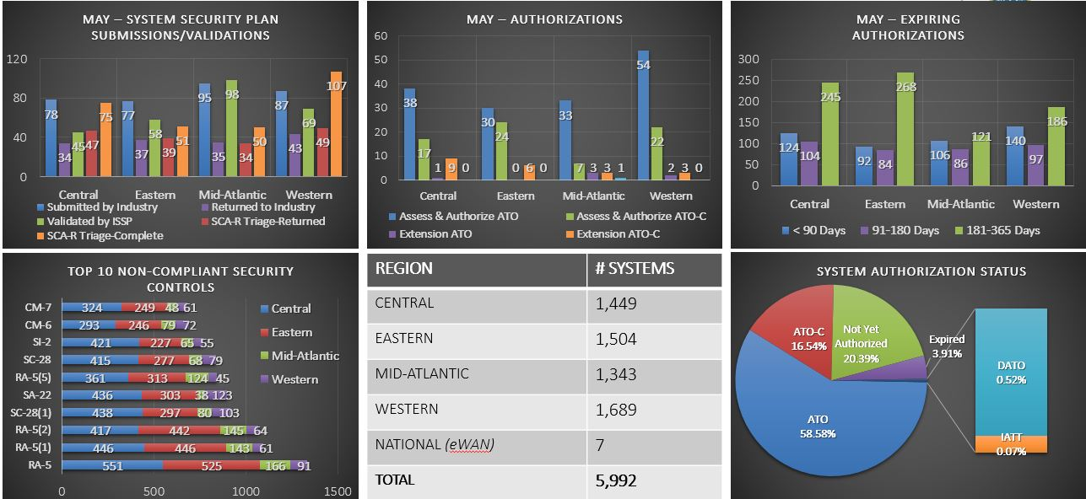
Workload Metrics
UNCLASSIFIED

Slide 9
Let’s Change Gears - Cyber Risk
UNCLASSIFIED
DCSA adopts the NISP Enterprise Mission Assurance Support Service (eMASS) as evidence and authorization decision repository for RMF Assess and Authorize process
  NISP eMASS - https://nisp.emass.apps.mil/Public/SiteAgreement
  Authorizations: Authorization to Operate (ATO); Authorization to Operate with Conditions (ATO-C); Denial of Authorization to Operate (DATO)
DCSA adopts NIST RMF as a common set of guidelines for the Assessment and Authorization (A&A) of Information Systems (ISs)
  RMF is a risk-based approach to cybersecurity
  DAAPM guides cleared industry in RMF and NISP eMASS to obtain and maintain an authorization
  Authorization decision is based on residual risk and Authorizing Official (AO) risk appetite
    High Residual Risk and High Impact Plans of Actions and Milestones (POAMs) impacts ATO decision
    AO reserves the right to prohibit granting a full ATO if an RMF package has at least one non-compliant control with a control residual risk level of “high” or “very high”

Slide 10
Cyber Compliance
UNCLASSIFIED
32 CFR Part 117 NISPOM – “Protection of classified information that is disclosed to, or developed by contractors of the U.S. Government (USG)”
  “Prescribes industrial security procedures and practices, under Executive Order 12829 or successor orders, to safeguard USG classified information that is developed by or disclosed to contractors of the USG”
  “Prescribes requirements, restrictions, and other safeguards to prevent unauthorized disclosure of classified information and protect special classes of classified information”
  “Prescribes that contractors will implement the provisions of this rule no later than 6 months from the effective date of this rule”
DoDM 5220.32 Vol 1 (Informational Only) – “Those non-DoD executive branch departments and agencies (referred to collectively as the “non-DoD Components”) identified in Part 117 of Title 32, Code of Federal Regulations (CFR), also known and referred to in this volume as the National Industrial Security Program Operating Manual (NISPOM). These non-DoD Components have entered into agreements with the Secretary of Defense (SecDef), pursuant to E.O. 12829, under which DoD acts as the CSA, to provide security oversight services to ensure the protection of classified information disclosed to or generated by contractors.

Slide 11
Contrast Cyber Risk and Cyber Compliance
UNCLASSIFIED
32 CFR Part 117 | Mapped to RMF Security Control Family
Part 117.12 – Security Training and Briefings | AT – Security Awareness and Training
Part 117.18 - General | Insider Threat and Cognizant Security Agency (CSA)-Issued Guidance
Part 117.18 - Information System Security Program | AC – Access Control; AT – Security Awareness and Training; AU – Audit and Accountability; CA – Security Assessment and Authorization; CM – Configuration Management; CP – Configuration Planning; IA – Identification and Authentication; IR – Incident Response; MA – Maintenance; MP – Media Protection; PE – Physical and Environmental Protection; PL – Planning; PM – Program Management; PS – Personnel Security; RA – Risk Assessment; SA – System and Service Acquisition; SC – System and Communications Protection; SI – System and Information Integrity
Part 117.18 – Contractor Responsibilities | Certification, Information System Security Manager (ISSM) and Officer (ISSO), IS User
Part 117.18 – Information System Security Life-Cycle | Initial Development, Continuous Awareness, Risk Management Decisions, Reciprocity
Part 117.18 – Risk Management Framework | Prepare, Categorize, Select, Implement, Assess, Authorize, Monitor

Slide 12
Conclusion
UNCLASSIFIED
DAAPM v2.2 (and future versions) rule the roost in regards to guidance on “how to” achieve an ATO in NISP DIB
DCSA ISSPs are industry’s first line of defense in achieving success. Communicate with these professionals to succeed in achieving an ATO and minimizing vulnerabilities (compliance)
RMF is a risk-based approach to cybersecurity; ATO decisions are risk-based
Compliance with 32 CFR Part 117 is mandatory and select RMF security controls walk-back to compliance items in 32 CFR Part 117
DoDM 5220.32 Volume 1 is provided for situational awareness; know what the GCA expects of cleared industry!
Team with your assigned ISSP for access to authoritative guidance and systems, and communicate, communicate, and communicate to smooth the ATO and compliance process

Slide 13
References
UNCLASSIFIED
National Institute of Technology and Standards (NIST) Special Publication (SP) 800-37r2 - Risk Management Framework (RMF) for Information Systems and Organizations: A System Life Cycle Approach for Security and Privacy
NIST SP 800-53r4 - Assessing Security and Privacy Controls in Federal Information Systems and Organizations: Building Effective Assessment Plans (and) r5 - Assessing Security and Privacy Controls in Information Systems and Organizations
NIST SP 800-series: https://csrc.nist.gov/publications/sp
32 CFR Part 117, NISPOM - https://www.dcsa.mil/mc/isd/NISPOM-Rule/
DoDM 5220.32, Vol 1 - NISPOM: Industrial Security Procedures for Government Activities https://www.esd.whs.mil/Portals/54/Documents/DD/issuances/dodm/522032v1.PDF?ver=1BFNVqOKXaqdXcO618H-yg%3D%3D
DCSA Assessment and Authorization Process Manual v2.2 **Available to cleared contractors processing classified information under the cognizance of DCSA**
CNSSI 1253 – Security Categorization and Control Selection for National Security Systems - https://www.cnss.gov/CNSS/issuances/Instructions.cfm
CNSSD 504 – Directive on Protecting National Security Systems from Insider Threat - https://www.cnss.gov/CNSS/issuances/Directives.cfm

Slide 14
UNCLASSIFIED
  QUESTIONS?

